Slide 1
DESIGN,PROTOTYPING AND CONSTRUCTION
Bhuvaneshwari Bodakuntla (bzb0159)
Grant Carpenter (gac0058)
Sam Clark (sjc0074)
Xu Chen (xzc0066)

Slide 2
Content
12.1 Introduction
12.2 Prototyping
12.3 Conceptual Design
12.4 Concrete Design
12.5 Generating Prototypes
12.6 Construction

Slide 3
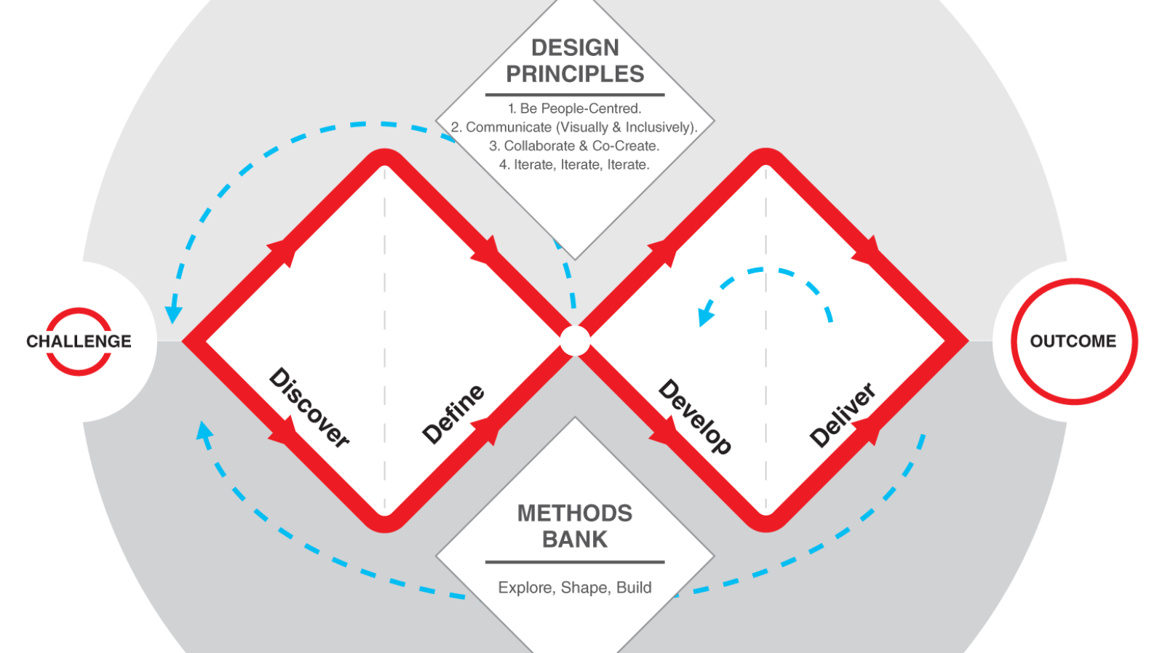
Introduction: Design, Prototyping, and Construction
Part of the Develop phase
Solutions or concepts are created, prototyped, tested and iterated.
Design-evaluation-redesign cycle
Design the product
Evaluate it
Redesign and go through the cycle again

Slide 4
Introduction: Conceptual vs Concrete
Conceptual: Focuses on the ideas for a product
Large focus on the Conceptual Model
Concrete: Focuses on the details of the design
Large focus on details and concrete decisions
Prototyping: Designers prototype to properly evaluate design ideas effectively.
Helps with the evaluation and redesign process

Slide 5
Prototyping

Slide 6
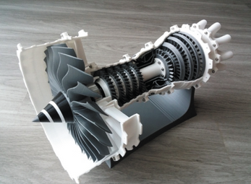
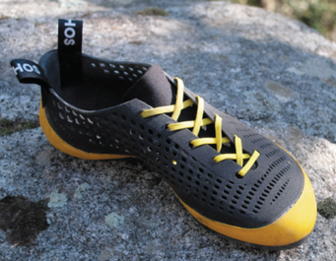
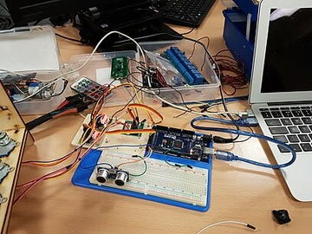
Prototyping
Prototypes provide a concrete manifestation of an idea.
Allows designer to communicate ideas
Allows other people to try them out

Slide 7
What is a Prototype?
“One manifestation of a design that allows stakeholders to interact with it and to explore its suitability”
Manifestation of a design
A visual depiction or explanation
Interactable
Stepping through the prototype
Limited
Emphasizes some aspects over others
Variety of Formats
Paper, Digital, Video, etc.

Slide 8
Why Prototype?
Communicate
Visually explain the design
Evaluate & Reflect
Consider various aspects of the design
Reflect on the design
Explore
Allow others to understand and experience the design deeper
Alternatives
What are some other options in the design? Should they be prototyped as well?

Slide 9
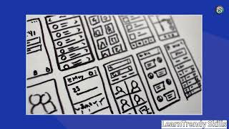
High- vs Low- Fidelity

Slide 10
Prototyping: Low-Fidelity
Simple, cheap, and quick to produce:
Does not look like the final product
May be made of paper or other materials
Main benefit:
Flexibility: Easy to modify, so you can test alternative designs
Cheap & Efficient: Low risk/cost to make
Four Common Types
Storyboarding
Sketching
Index Cards
Wizard of Oz

Slide 11
Low-Fidelity: Storyboarding and Sketching
Storyboarding
A series of sketches walking through the usage of a product
Like a simplified comic strip, used to display the product and its use cases
Sketching
Visual drawing/depiction of a use case/interaction
The basis for storyboarding
Sketching vocabulary: Someone’s own derived symbols and icons they use for design sketching.

Slide 12
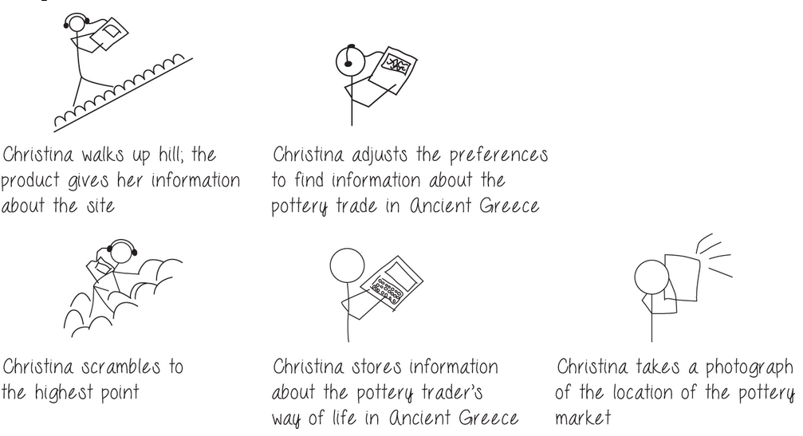
Example: Storyboarding
Example: The storyboard shows sketches of Christina interacting with various objects.

Slide 13
Low-Fidelity: Index Cards and Wizard of Oz
Index Cards
Main medium: Index cards, sticky notes, etc.
Each card represents an element of interaction like a screen, icon, menu, dialogue, etc.
Users can step through the cards, simulating the performance of tasks/interactions of the product.
Wizard of Oz
A software-based prototype
Participants interact with software as if it was the product
But a human operator is “behind the curtain”
Example: A chatbot, but instead of the bot responding, there is a human on the other end

Slide 14
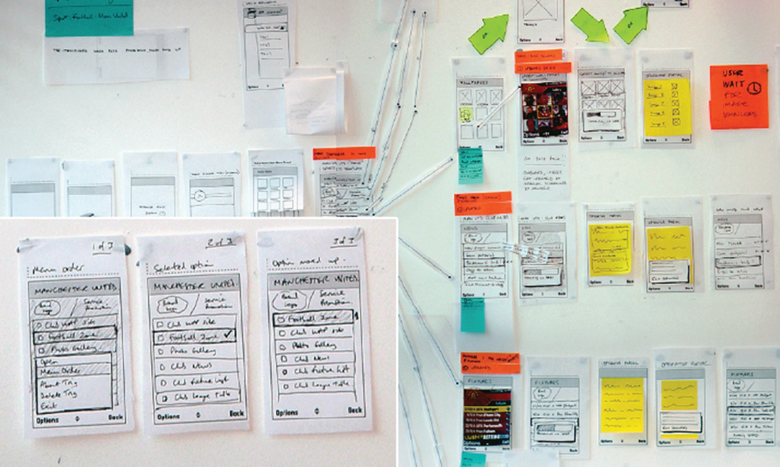
Example: Note Cards
Example: The image shows various linked cards the user could step through to simulate the interactions of the design.

Slide 15
Prototyping: High-Fidelity
Semi-functional prototype:
Looks more like the final product
Usually software
Main benefit:
Functionality: You can experience some of the actual product’s functionality and evaluate/consider aspects of the product
Partial testing: Because of the functionality, you can essentially test various aspects to see if they properly work together

Slide 16
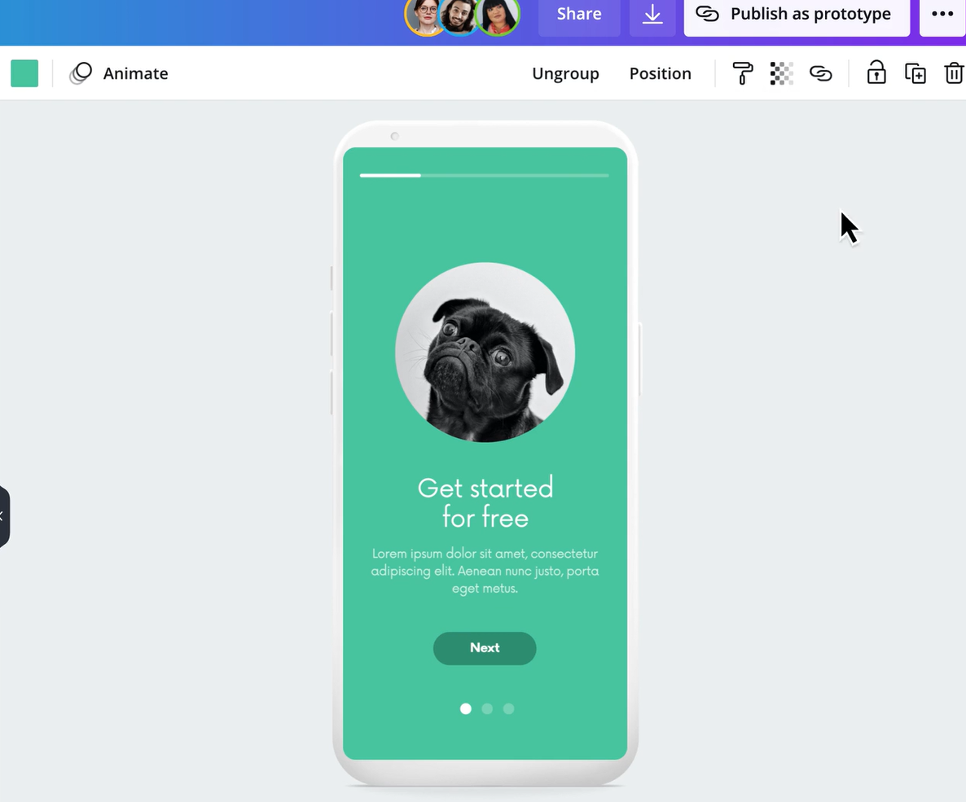
Example: High-Fidelity Canva Prototype
Example: The image shows an add from Canva, where a high-fidelity prototype for a mobile app is being developed.

Slide 17
Prototyping: Compromises
Compromises: the intention is not to create the product but to quickly test an aspect of it.
Low-Fidelity: Lower quality/scope. In paper-based implementations, the device does not work.
High-Fidelity: Limited functionality/scope. Often error-catching will not exist or certain aspects will be left unaddressed.
Horizontal vs Vertical Prototyping:
Horizontal: Providing a wide range of functions with little detail (large coverage but shallow)
Vertical: Providing a lot of detail for only a few functions (small coverage but deep)
Robustness vs Changeability:
Robust: More in-depth, but may be harder to change
Changeable: Easier to change, but may be less specific

Slide 18
Conceptual Design

Slide 19
Conceptual Design:Crafting User Experience
Definition of Conceptual Design
—— Develops a conceptual model
—— Defines what people can do with a product
—— Identifies concepts needed to interact with it
Definition of Conceptual Model
An outline of what users can do with a product and the concepts they need to understand how to interact with it.

Slide 20
Empathy in Design: Challenges and Limits
Experience Prototyping
—— A technique to help design teams understand the user's experience.
Example: simulating defibrillator shocks via random alerts gained insights into user anxiety
Limitations of Simulation
—— Disability simulations can lead to negative feelings
—— Short-term simulations don't account for the coping strategies people develop over time.

Slide 21
Tools for Exploring Design Ideas
Plus and minus scenarios (Bodker, 2000) —— Best/worst outcomes —— provide a comprehensive view
Contravision (Mancini et al., 2010)
positive vs. negative video scenarios
Mood boards
capture desired feel of the product

Slide 22
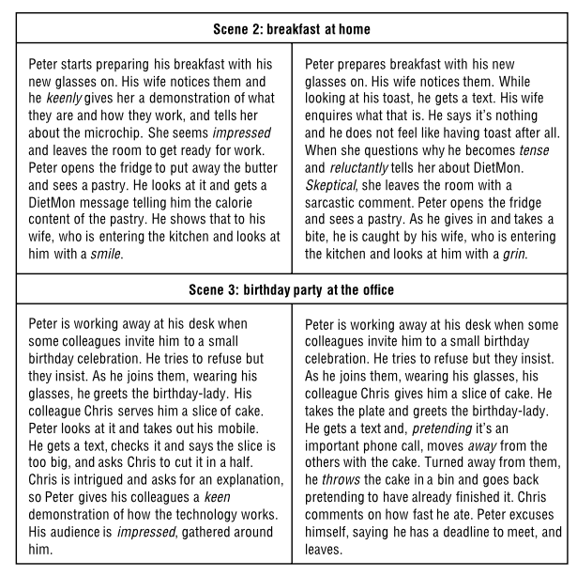
Example: Using Contravision Across Two Scenes
Source: Price et al. (2010)

Slide 23
Initial Conceptual Model: Three Key Approaches
Interface Metaphors How can we use familiar concepts to help users understand the product?
Interaction Types Which interaction styles (e.g., instructing, conversing) best support the user's activities?
Interface Types What kinds of interfaces (e.g., tangible, virtual reality) could offer new design insights?

Slide 24
Definition: Combining familiar and new knowledge
Interface Metaphors:
Bridging Familiar and New
Process:
Understand functionality
Identify user problems
Generate & evaluate
Evaluation Questions:
Provides structure?
Relevant?
Easy to represent?
Audience understands?
Extensible?

Slide 25
Interaction Types: User-Product Communication
Five Types Instructing, conversing, manipulating, exploring, responding
Usage Most products use a combination
Example (Travel App) Find visa info. / refine vacation options / choosing a route / virtual walkthrough / system ask question

Slide 26
Interface Types: Inspiring Design Alternatives
Purpose Prompt new design ideas
Guided by User and environmental needs
Example (Travel App) —— Shareable: for group use —— Tangible: physical object interaction —— Virtual Reality: Experience destination

Slide 27
Expanding the Model
Next Step: Prepare for prototyping & evaluation
Details Needed： —— Product functions —— User functions —— Function relationships —— Information needs
Process: Evolves with prototyping & feedback

Slide 28
Concrete Design

Slide 29
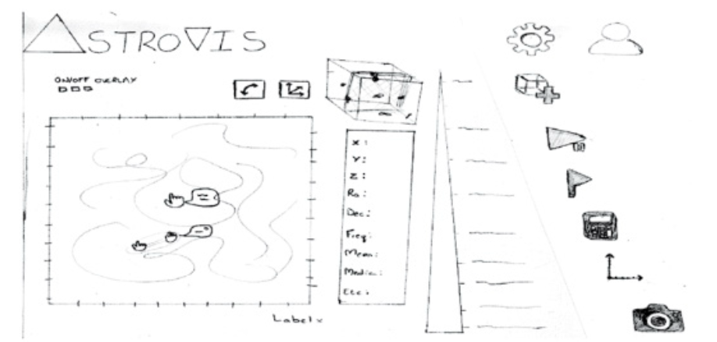
What is Concrete Design?
Turns conceptual ideas into real, detailed design decisions
Involves layout, colors, navigation, icons, interactions
Focus: How the system works and feels
Example: Paper prototypes for astronomy visualization (Rampersad et al., 2017)

Slide 30
Key Elements of Concrete Design
Visual appearance: colors, icons, typography
Navigation & layout: grouping + hierarchy
Interaction: touch, voice, mouse, keyboard
Feedback: responses to user actions
Iteration: prototypes → testing → refinement
Good concrete design = clarity + usability + aesthetic balance.

Slide 31
Accessibility & Inclusiveness
Accessibility: design usable by all abilities
Screen readers, Braille, voice commands, captions
Guided by WCAG standards
Inclusiveness: beyond disability → culture, language, gender, economics
Different user groups require tailored interfaces
Goal: fair, open, and equal experience for everyone

Slide 32
Localization & Internationalization
Concrete design must adapt to local culture and audience
Example: Coca-Cola websites across countries differ in:
Layout & typography
Faces & imagery
Local content & news
Localization ensures relevance; internationalization ensures flexibility
Design should feel local, no matter where it’s viewed.

Slide 33
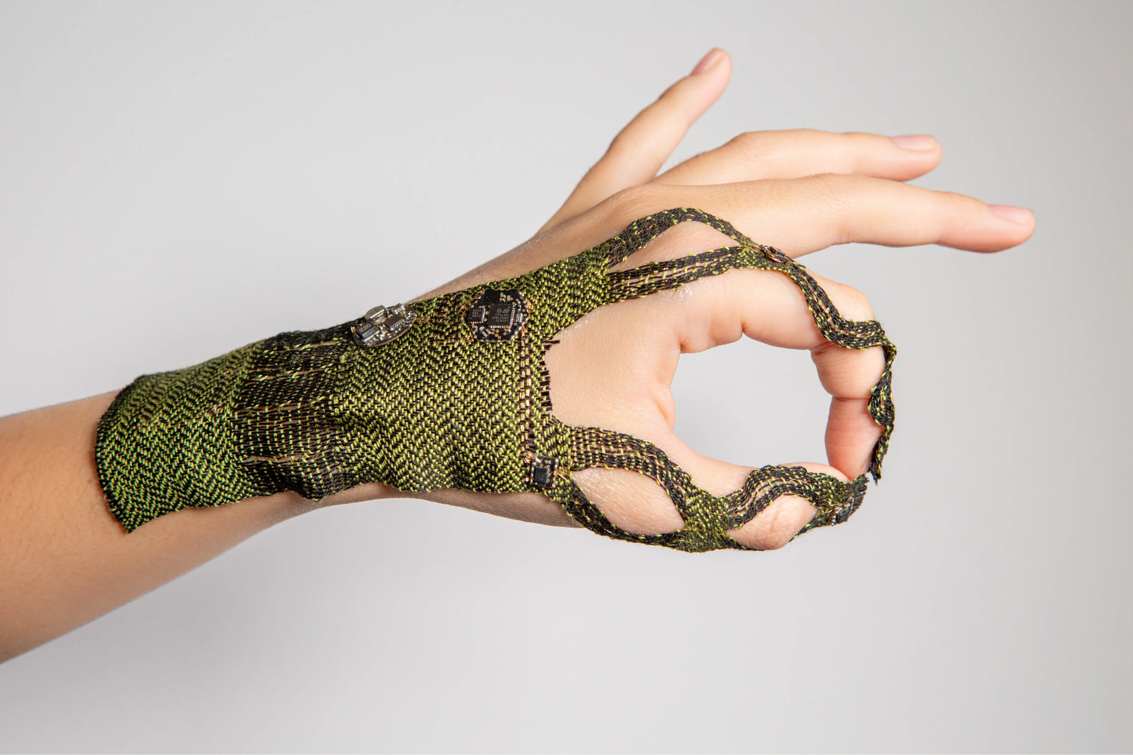
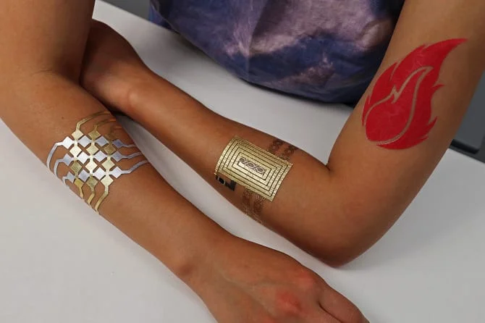
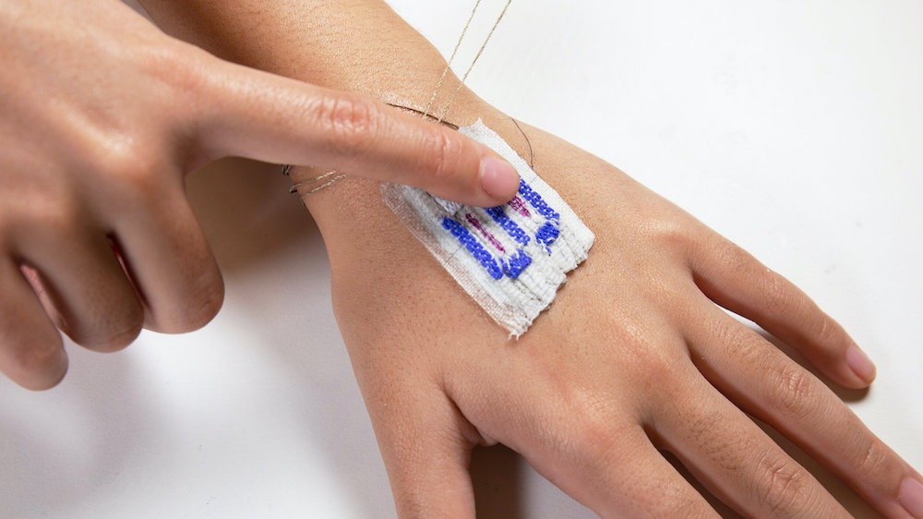
Research through Design (RtD)
Uses design as a research method to explore new ideas
Produces knowledge through making
Focuses on reflection and iteration
Example: On-skin interfaces via woven circuitry (Huang et al., 2021)

Slide 34
Activities
Activity 1: Accessibility Audit
Pick any app (e.g., Spotify). → List 2 accessibility problems + 1 improvement.
Activity 2: Localization Check
Compare Coca-Cola USA vs Coca-Cola India websites. → Identify one difference in layout or content tone.
Key Takeaway: Concrete Design connects concepts to reality, balancing usability, aesthetics, and inclusivity.

Slide 35
Generating Prototypes

Slide 36
Generating Prototypes
Prototypes serve as a bridge between requirements and interaction design, helping visualize how users will actually engage with a product.
Generating a prototype begins with understanding user goals, scenarios, and requirements, then choosing the right way to visualize interactions.
There are two main approaches to generating prototypes:
Storyboards
Card-Based Prototypes
Then there are two main approaches to mapping the experience of the user:
Experience Wheel
Timeline
Both approaches must be used to gain a full understanding of the situation, pain points, and other issue that need to be solved.

Slide 37
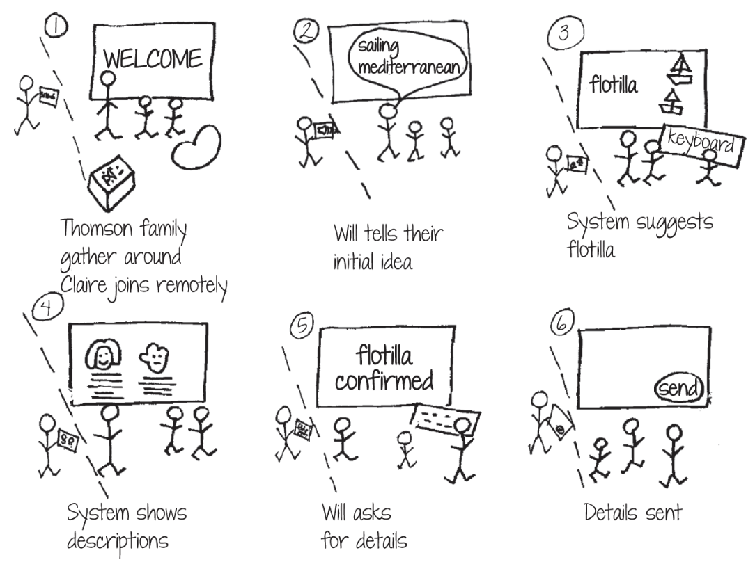
Storyboards
As previously discussed Storyboards are a low fidelity prototype that help designers and stakeholders visualize how a user interacts with a product step by step.
The best time to use Storyboards are at the very beginning of the design process
They show context, environment, and key
actions, making it easier to spot design
problems early.
The example in the image shows a
family using a travel organizer to plan a
Mediterranean sailing trip.

Slide 38
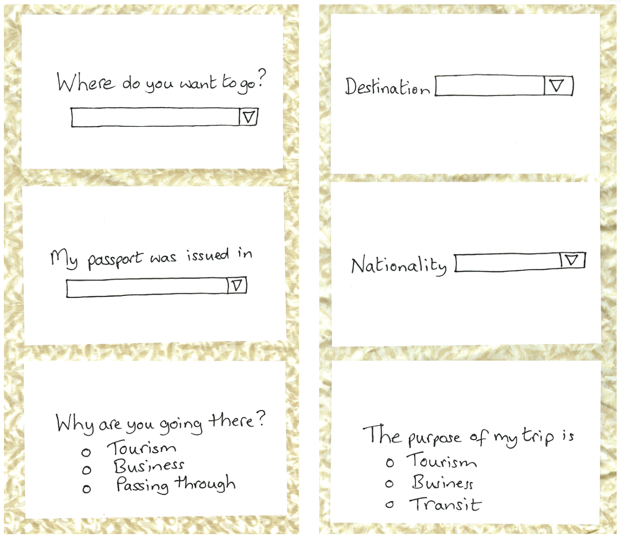
Card-Based
Card-based prototypes help designers plan and test interactions early in the design process.
Each card represents a screen, action, or message, which can be easily rearranged to explore different user paths.
Just like the Storyboard, Card-Based
Prototypes are used in the early stages of
design on systems that contain multiple
interactions and paths the user can take.
The example shown is a travel organizer very
similar to one of our earlier assignments.

Slide 39
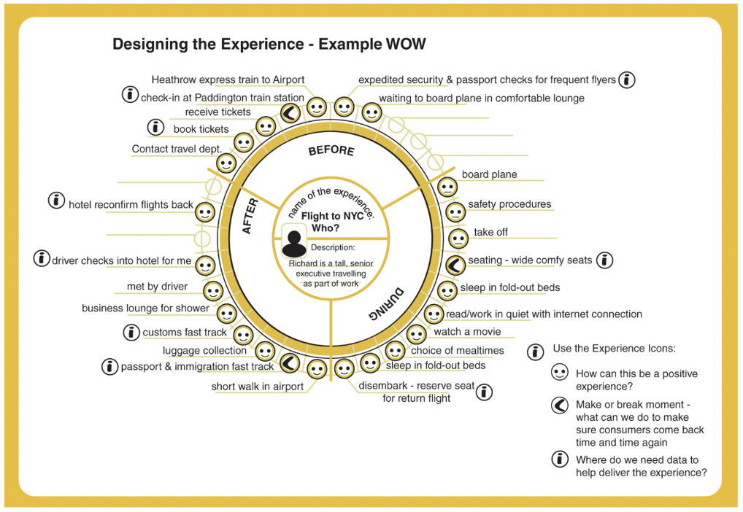
Experience Wheel
The experience wheel helps visualize the entire user journey, from start to finish, as a repeating cycle.
It’s useful for finding patterns, emotional highs and lows, and areas that may need improvement.
When the user experience is cyclical or
ongoing, such as flying, shopping, or
subscription-based products.Best for
showing how users move through
repeated phases, not just one linear
process.
The example shown takes us through
someone traveling through an airport.

Slide 40
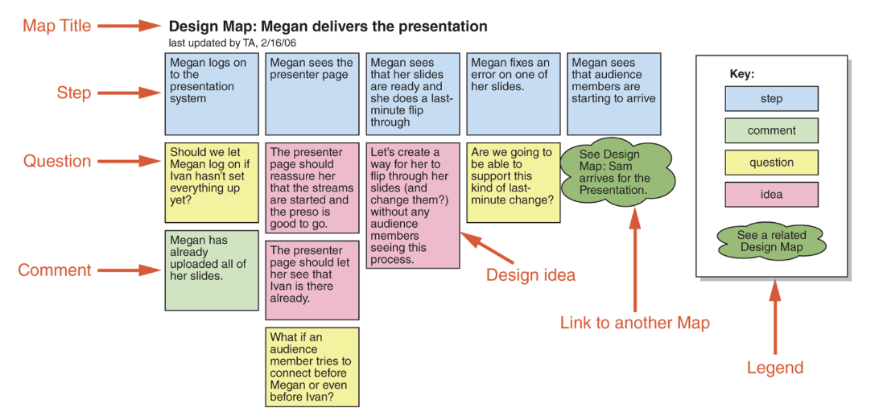
Timeline
Timeline show how a user’s experience unfolds step-by-step over time. They help designers pinpoint specific moments of success or frustration.
This approach is commonly used in linear experiences like online shopping, delivery service, etc.
The ability to spot specific pain points on the timeline makes solving issues much quicker and efficient
The following example shows
Megan constructing and
delivering a presentation

Slide 41
Construction

Slide 42
Construction
The construction phase is where designs become real, moving from prototypes to working products.
It focuses on building higher-fidelity versions using tools and pre-made components.
Designers almost never begin entirely from scratch; instead, they leverage existing kits and libraries to accelerate the development process.
These include the following:
Physical Computing Kits
Software Development Kits (SDKs)

Slide 43
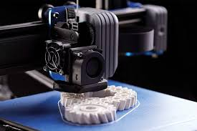
Physical Computing
Physical computing bridges the gap between digital design and real-world interaction.
It allows designers to prototype and test ideas by building and programming interactive devices that respond to the physical environment.
Physical computing relies on electronic components
and toolkits that make experimentation accessible.
These toolkits, such as Arduino, LilyPad,
Raspberry Pi, and BBC micro:bit let designers
rapidly create and test working systems without
starting from scratch.

Slide 44
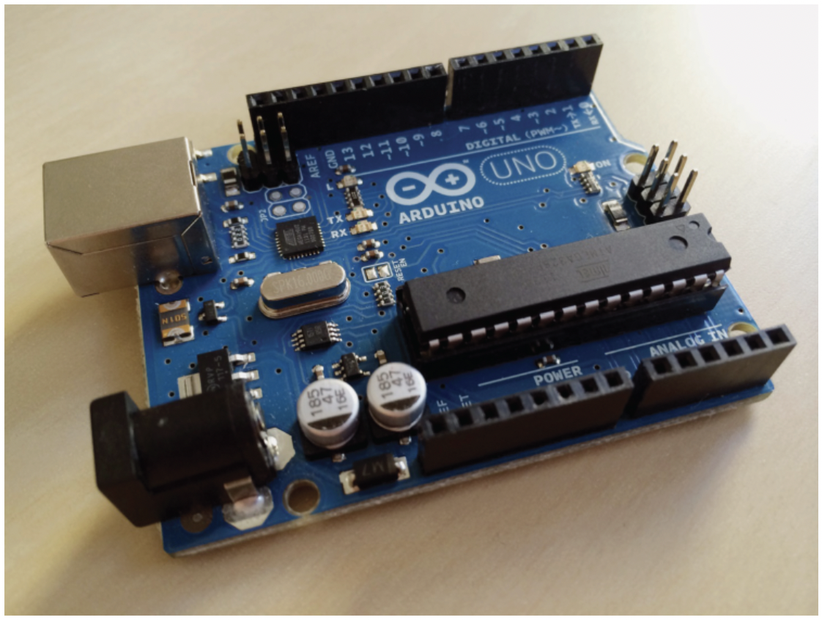
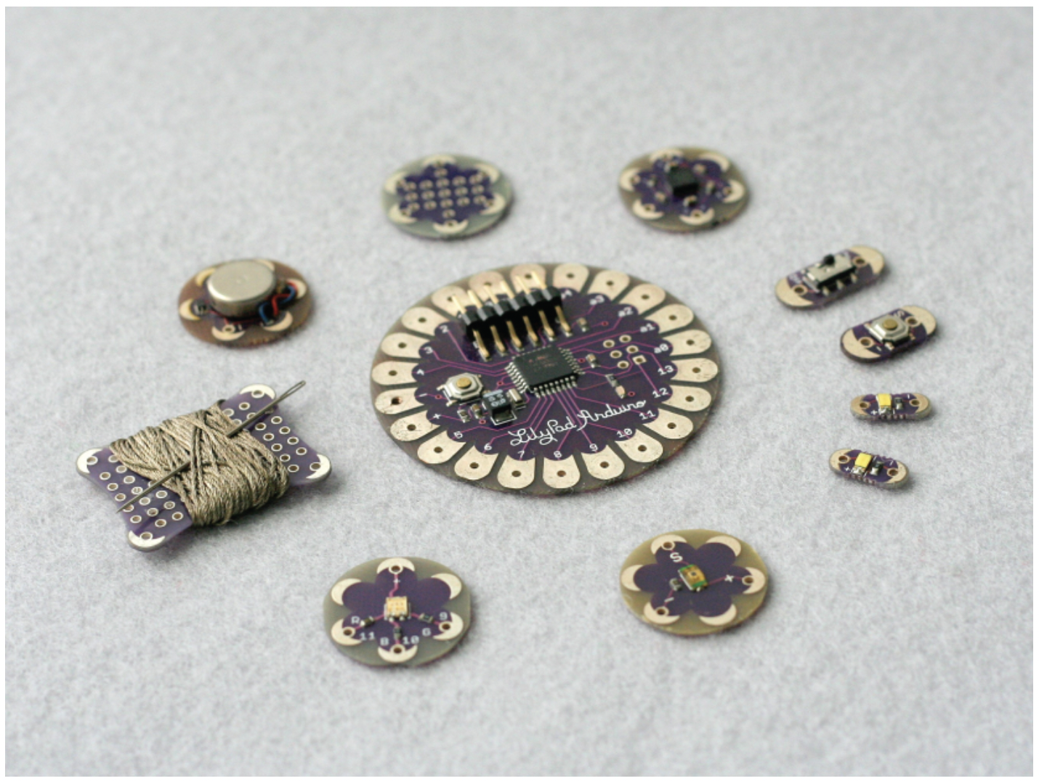
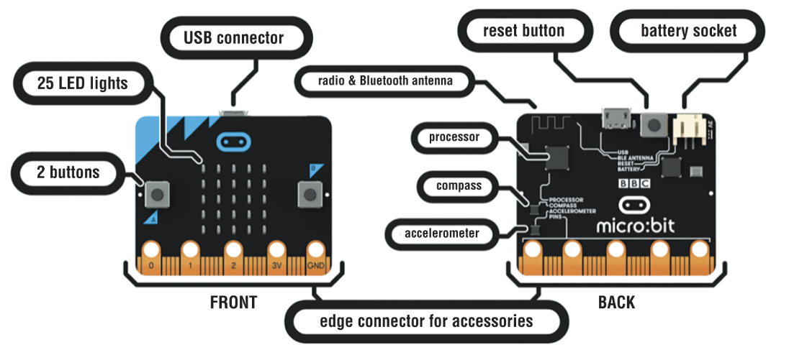
Physical Computing (continued)
Arduino: A beginner-friendly toolkit for learning how to code and build prototypes. Includes an Arduino board and a simple coding environment (IDE) for uploading programs.
LilyPad: Developed from the basic Arduino kit, the LilyPad is a set of sewable electronic components for building fashionable clothing and other textiles
BBC Micro:bit: A small device with built-in sensors and LEDs, no wiring required. Supports both block-based coding and JavaScript, ideal for beginners.

Slide 45

Software Development Kits
A software development kit (SDK) is a package of programming tools and components that supports the development of applications for a specific platform.
For example, iOS on iPhone and iPad or Android on mobile phones and tablets.
An SDK generally provides an IDE, documentation, drivers, sample code, and APIs that enable developers to integrate and control
components without in-depth knowledge of their internal
workings.
A well-known example is the Unity SDK, which allows
developers to create interactive games, simulations, and
virtual reality (VR/AR) experiences across multiple platforms.

Slide 46
THANK YOU

